Slide 1
Computer Organization & Assembly Language (CSC-205)
Lecture 14

Slide 2
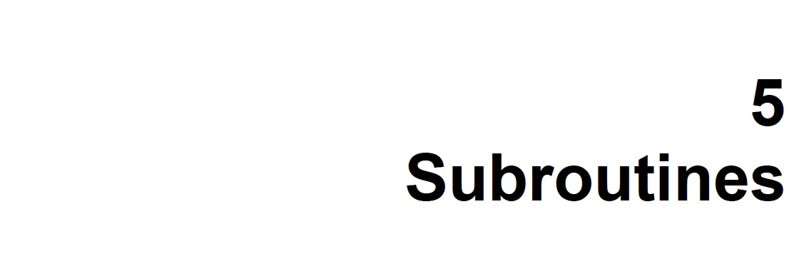

Slide 3
5.1. PROGRAM FLOW
What Has Been Learned So Far?
You’ve learned basic tools of assembly language, especially conditional jumps.
You've already written useful sorting and multiplication algorithms.
Reusability Issue in Large Programs?
Programs often need sorting or multiplication at many places.
Copying the same code 100 times is hard to manage, error-prone, and wasteful

Slide 4
5.1. PROGRAM FLOW
Naive Approach : Using Labels and Jumps
One simple way is to put sorting code in one place and use JMP to go to it.
But once the sorting finishes, how does the code know where to return?
A regular jump (JMP) goes only in one direction — there’s no built-in way to go back.
Program Flow Analogy
A program is like a thread — all instructions are connected in a line.
A jump is like a permanent turn on a highway — it breaks the thread and goes away.
Conditional jumps pick between two paths, but they don’t allow return either.

Slide 5
5.1. PROGRAM FLOW
Roundabout Analogy (Temporary Diversions)
Just like roundabouts bring you back to your original path:
We want a way to temporarily jump to a task (like sorting),
And then come back to where we left off
Conclusion
Assembly language needs a feature that lets you:
Go to a task (e.g., sorting)
And then return back after it’s done
This idea leads to subroutines or procedures — a concept that will be introduced to handle such needs.

Slide 6
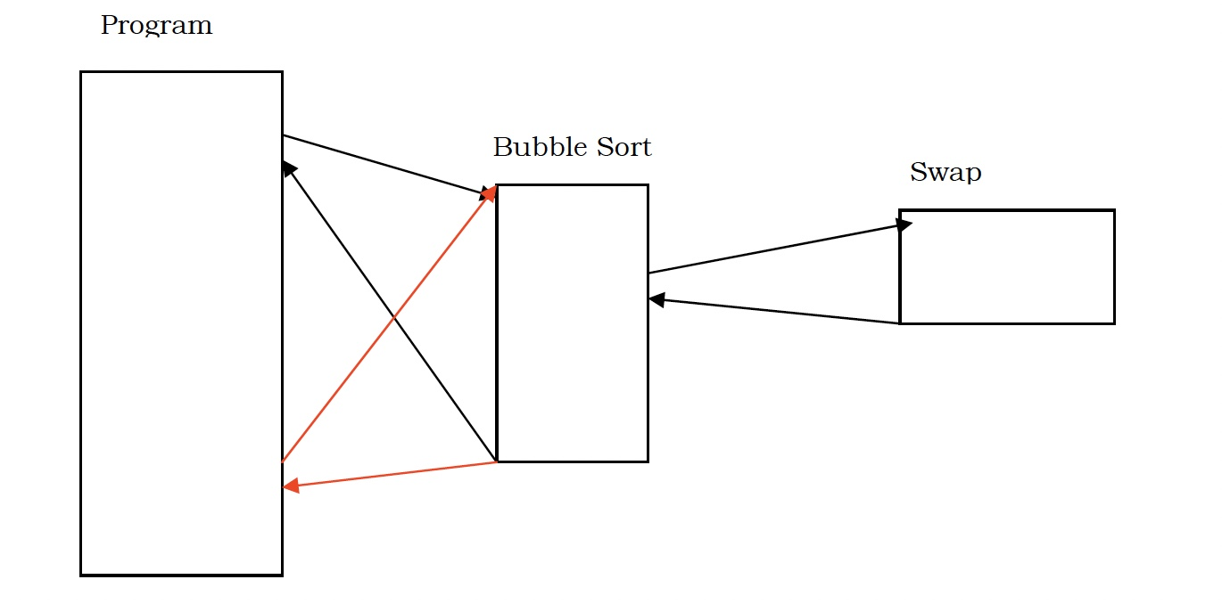
5.1. PROGRAM FLOW

Slide 7
5.1. PROGRAM FLOW
Key Idea Explained:
The program calls a procedure (e.g., Bubble Sort)
The procedure may call another procedure (e.g., Swap)
After execution, control returns to the point right after the call
This temporary diversion is like a loop in thread

Slide 8
Simple Comparison of Procedure, Loop, and Label in Assembly Language
1. Procedure (Subroutine)
A procedure is a reusable block of code that performs a specific task and can return to where it was called from
Used for: Reusable code (e.g., sorting, multiplication)
Returns back to the caller after execution (CALL and RET instructions)
Can be called multiple times from different places in code
Like a function in high-level languages

Slide 9
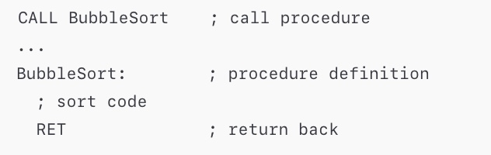
Simple Comparison of Procedure, Loop, and Label in Assembly Language
1. Procedure (Subroutine) - Example

Slide 10
Simple Comparison of Procedure, Loop, and Label in Assembly Language
2. Loop
A loop is a structure that repeats a block of code multiple times based on a condition.
Used for: Repeating actions (like iterating over an array)
Stops repeating when a condition is false
Uses instructions like LOOP, JMP, or JNZ to repeat

Slide 11
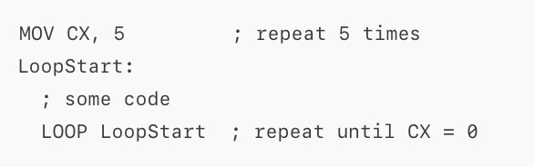
Simple Comparison of Procedure, Loop, and Label in Assembly Language
2. Loop - Example

Slide 12
Simple Comparison of Procedure, Loop, and Label in Assembly Language
3. Label
A label is a named point in the code that you can jump to.
Used for: Marking a location in code
Works with jump instructions (JMP, JE, JNE, etc.)
Does not return back automatically after jumping

Slide 13
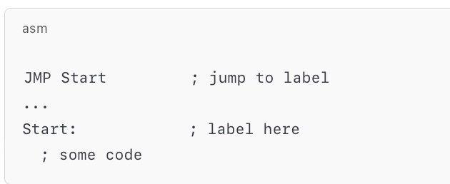
Simple Comparison of Procedure, Loop, and Label in Assembly Language
3. Label - Example

Slide 14
CALL and RET
Purpose of Diversion
Processors support both temporary and permanent diversions
Permanent diversion: JMP (Jump Instruction)
Temporary diversion: CALL (Call Instruction)
What is CALL?
Similar to subroutine/function call in high-level languages
Allows temporary diversion for code reuse (e.g., Bubble Sort)
Syntax: CALL label (jumps to the label’s code)
Unlike JMP, CALL remembers the return address

Slide 15
CALL and RET
What is RET?
RET = Return: Returns control to the instruction after CALL
Takes no argument – the processor knows where to return
Works using the system stack (will discuss later)
CALL and RET Pairing
Normally used together (CALL → RET)
Technically independent:
CALL works even without a RET
RET works even without a CALL.

Slide 16
Parameters in Subroutines
Why Parameters Are Needed?
CALL lets us reuse code like Bubble Sort
But without parameters, it always sorts:
The same array
In the same way (e.g., ascending only)
Real applications need:
Parameters = Information passed from caller to subroutine
Let the subroutine behave differently based on input

Slide 17
Parameters in Subroutines
How to Pass Parameters
Use registers to store parameter values
CALL:
Temporarily changes execution flow
Does not change registers (except IP and SP). So we can use general-purpose registers (AX, BX, etc.) to send values
Summary:
Parameters make subroutines flexible and reusable
Registers are the simplest way to pass them

Slide 18
5.2. OUR FIRST SUBROUTINE
Now we want to modify the bubble sort code so that it works as a subroutine. We place a label at the start of bubble sort code, which works as the anchor point and will be used in the CALL instruction to call the subroutine. We also place a RET at the end of the algorithm to return from
where we called the subroutine.

Slide 19
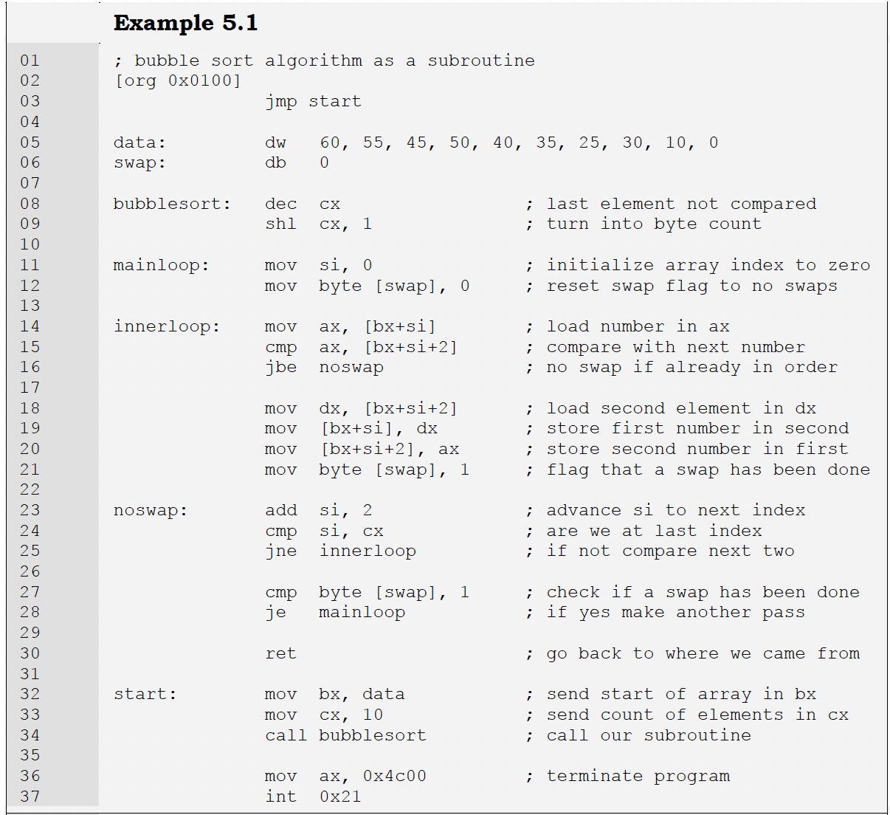

Slide 20
5.2. OUR FIRST SUBROUTINE
Subroutine Structure
Label bubblesort: marks the entry point for CALL
RET ends the routine and returns to the calling location
Parameters Passed
CX: Number of elements to sort
Decremented by 1 (last element doesn't need comparison)
Multiplied by 2 (since it's a word array → 2 bytes per element)
BX: Base address of the array
SI: Offset/index into the array
Base + Index + Offset addressing is used (i.e., [BX+SI], [BX+SI+2])

Slide 21
5.2. OUR FIRST SUBROUTINE
Main Program (Like C main())
Label start: is the main routine
mov bx, data → pass base address of array
mov cx, 10 → pass number of elements
call bubblesort → invoke subroutine
What Happens During CALL
Execution jumps to bubblesort
IP (Instruction Pointer) changes
SP (Stack Pointer) is decremented by 2
Return address (e.g., 0150) is pushed on stack
RET later pops this address back into IP → resumes from where CALL was made

Slide 22
End of Lecture

